Slide 1


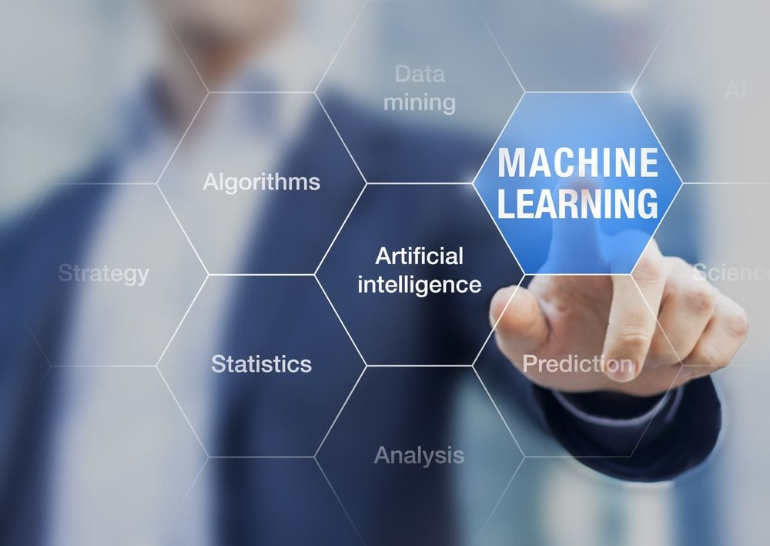

Fundamentals of Python for Machine Learning, Data Science & Web Development

Slide 2
Agenda
Role of DATA
Data Science
Machine Learning
Checkout some live observations
Why and what is ML
Types of Type of ML Algorithm
Steps in Data Modelling and Machine Learning Process
30 hours Program Delivery Plan
Q&A

Slide 3
Training Deliverables & Takeaways
Industry Ready Curriculum
Interactive & Doubt Session
Certification Program
Career Guidance
Projects/Practical Based Learning

Slide 4
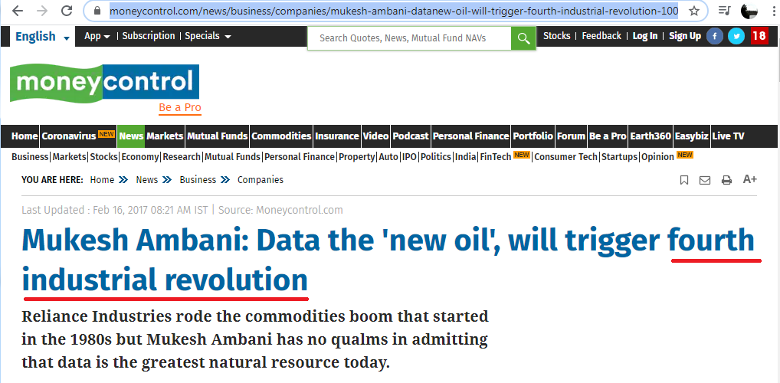
Future Development would be around “DATA”

Slide 5
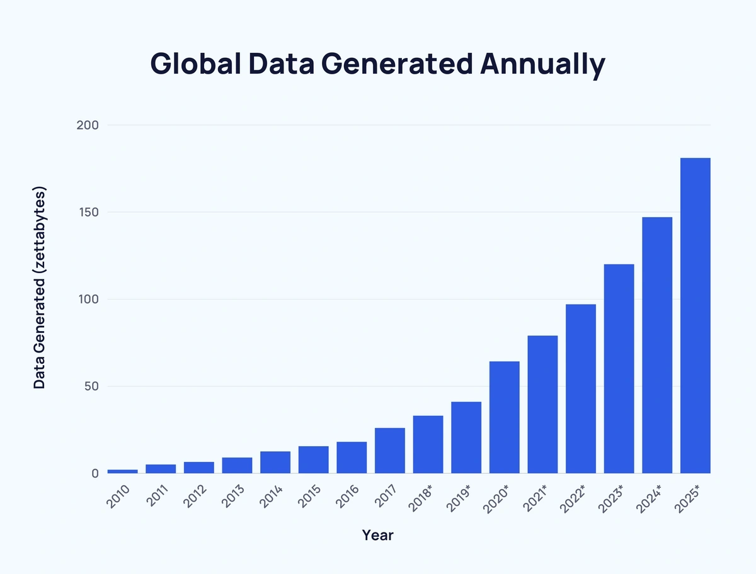
DATA GENERATED ANNUALLY

Slide 6
Live Observations

Slide 7
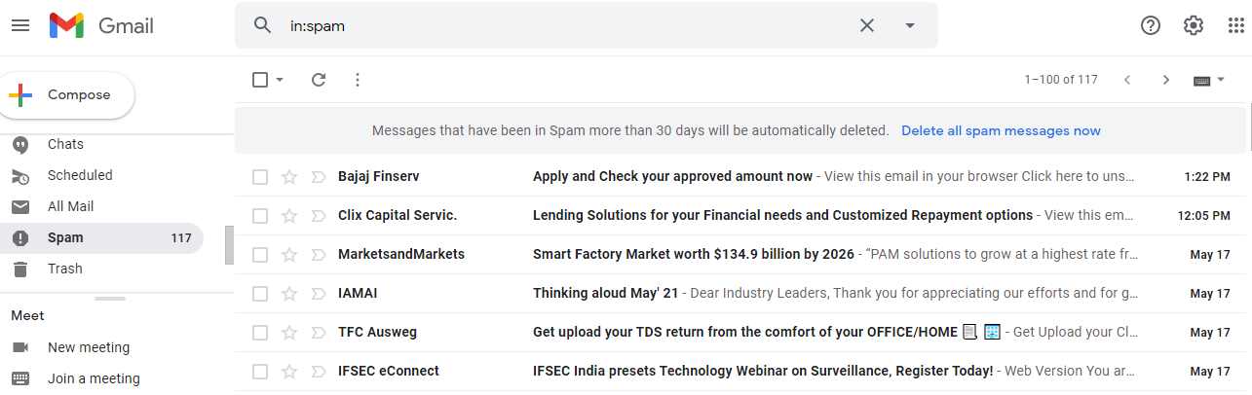
Usecase 1: Junk Mail Folder

Slide 8
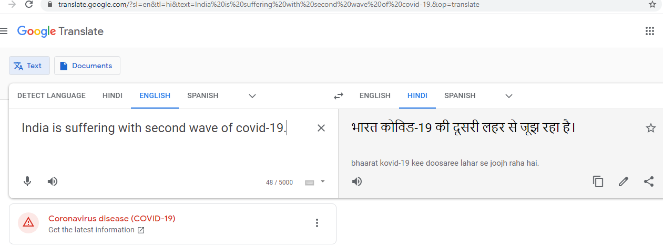
Usecase 2: Google Translate

Slide 9
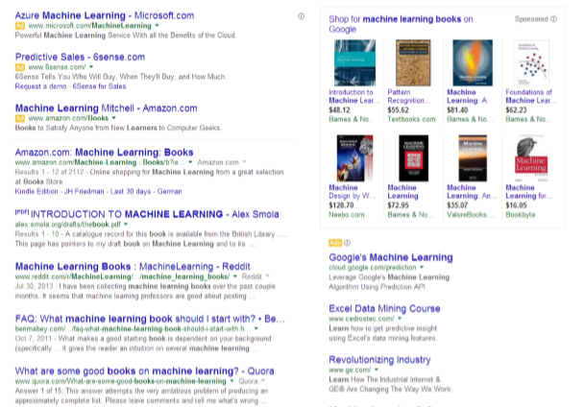
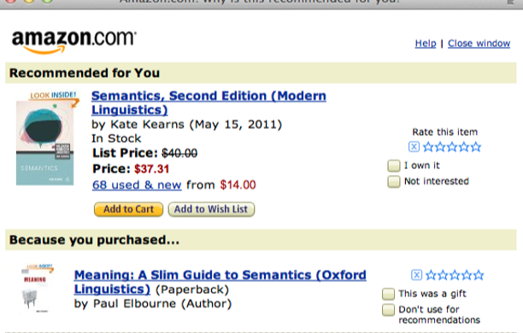
Usecase 3: Recommendations

Slide 10
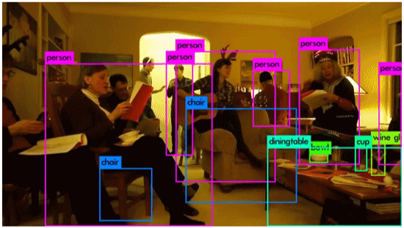
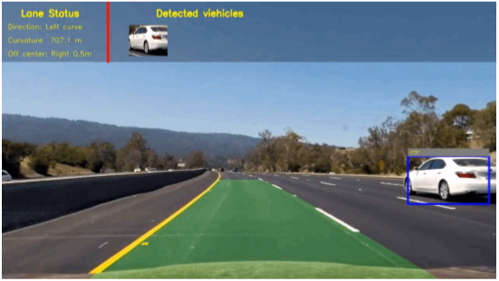
Usecase 4: Object Recognition

Slide 11



Other Usecases in DS-ML
EVERY INDUSTRY and BUSINESS
is using data science and machine learning in some form or the other
IT & Education
Healthcare & E-commerce
Pharma & Energy
Media & Entertainment
Telecom
Retail & CPG
Travel & Hospitality
Automoblie

Slide 12




Other Use-cases in DS-ML
Analyze & Visualize Employee Attrition
Predictive Maintenance
Analyze & Visualize Video Games Sales
Identify fraudulent credit card transactions
Smart City Sustainability

Slide 13
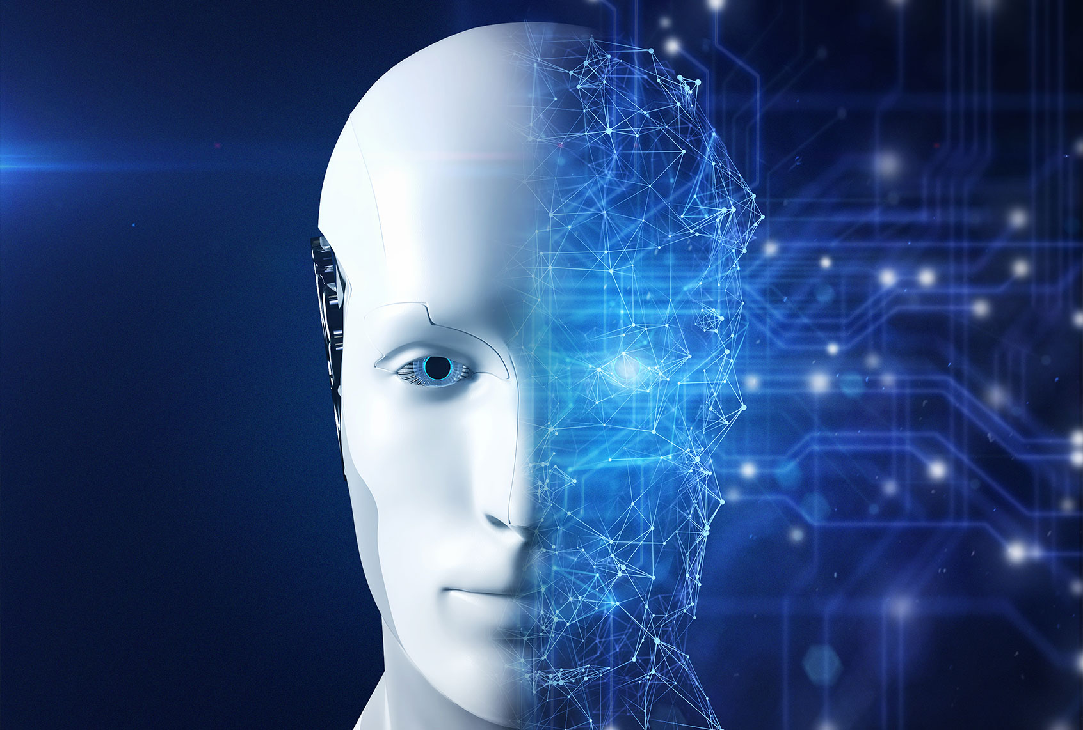
DS-ML Market Projection
Data Science, Machine Learning are redefining our way of life, enabling machines to do what people once thought only humans could do.
It is also revolutionizing the way we do business.
The global ML market is projected to be $30.6B by 2024.

Slide 14
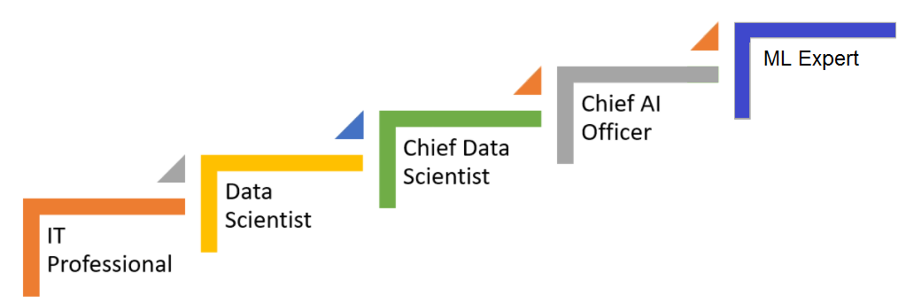
Career Path
Notes:
1 min

Slide 15
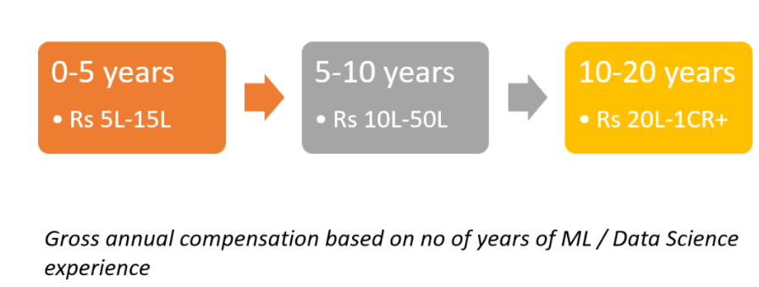
Salaries
Notes:
1 min

Slide 16
Why and what is ML

Slide 17
Machine Learning
Machine learning is program computers, to optimize performance using huge amount of data or past experience.
Machine learning can automatically detect patterns in data and then to use the uncovered patterns to predict future data or other outcome of interest.
Skills Acquired
Experiences
Human Learning
Learning
Lots of data
Predictions
Machine Learning
Models

Slide 18

Machine Learning
Traditional Programming
Data
Output
Program
Machine Learning
Data
Program
Output

Slide 19
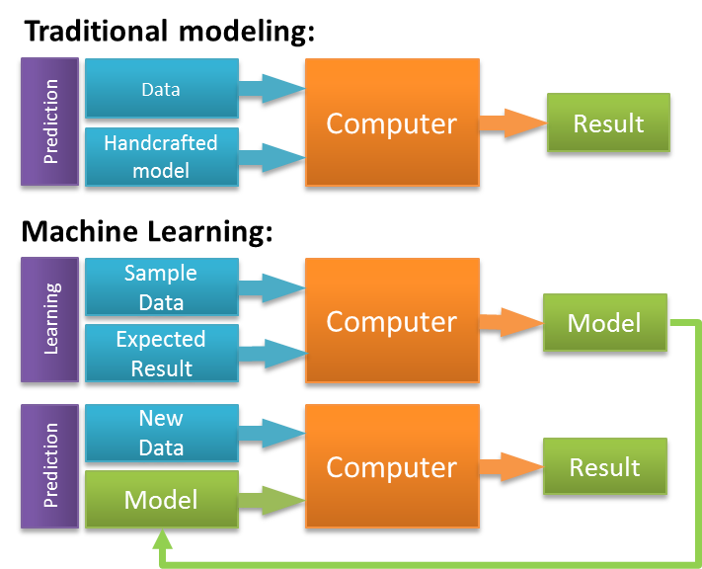
Machine Learning

Slide 20
Machine Learning
“Machine Learning: Field of study that gives computers the ability to learn without being explicitly programmed.” -Arthur Samuel (1959)

Slide 21
Types of Learning
Supervised (inductive) learning
Given: training data + desired outputs (labels)
Unsupervised learning
Given: training data (without desired outputs)
Reinforcement learning
Rewards from sequence of actions

Slide 22
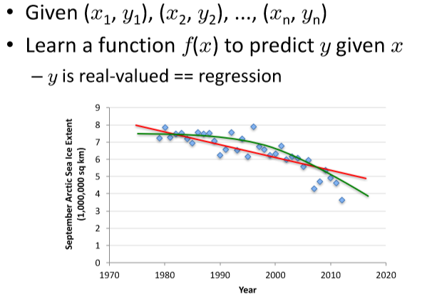
Supervised Learning: Regression

Slide 23
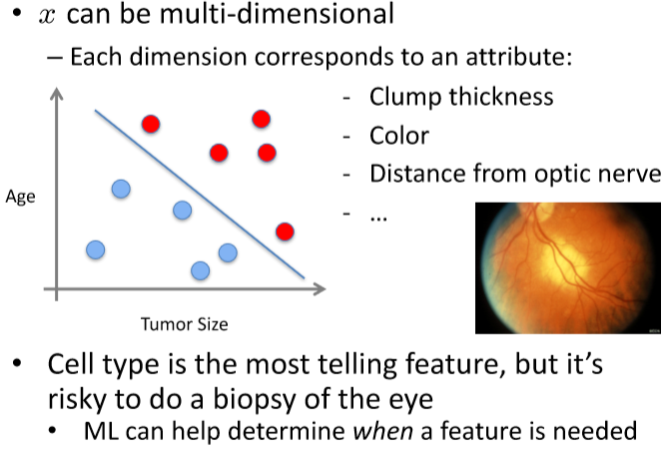
Supervised Learning: Classification

Slide 24
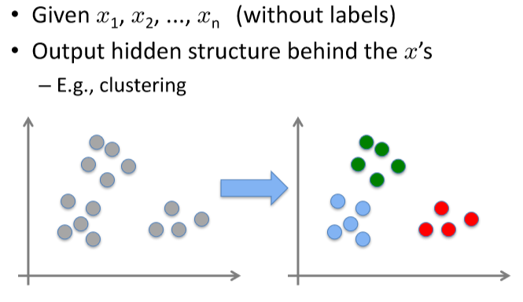
Unsupervised Learning

Slide 25
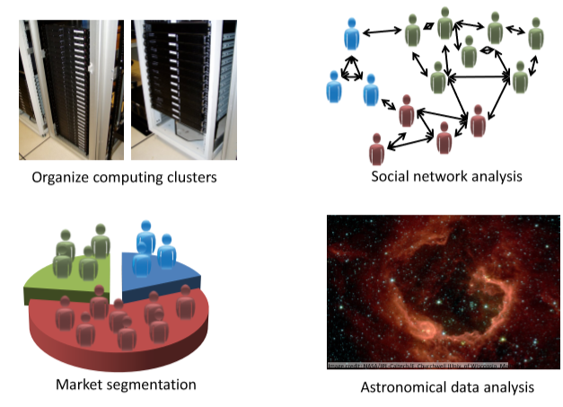
Unsupervised Learning

Slide 26
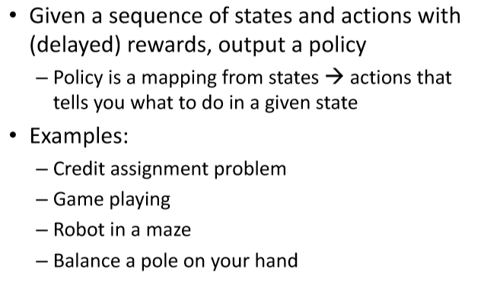
Reinforcement Learning
https://www.youtube.com/watch?v=gn4nRCC9TwQ

Slide 27
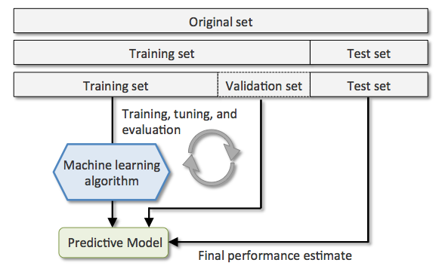
Set of steps in Machine Learning
Define: The data that you want to study in order to solve a problem or meet an objective.
Collect data
Filter data
Analyze data
Train algorithms
Test algorithms
Use algorithms for future predictions
Notes:
Format: The data might be spread in different files. For example, sales results from different countries with different currency, languages, etc. which needs to be gathered together to form a data set.
Data Cleaning: In this step, our goal is to deal with missing values and remove unwanted characters from the data.
Feature Extraction: In this step, we focus on analysis and optimisation of the number of features. Usually, a member of the team has to find out which features are important for prediction and select them for faster computations and low memory consumption.

Slide 28
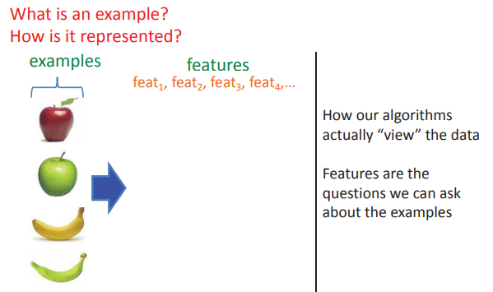
Representing Examples

Slide 29
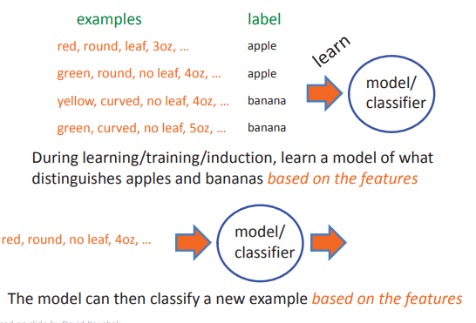
Learning System

Slide 30
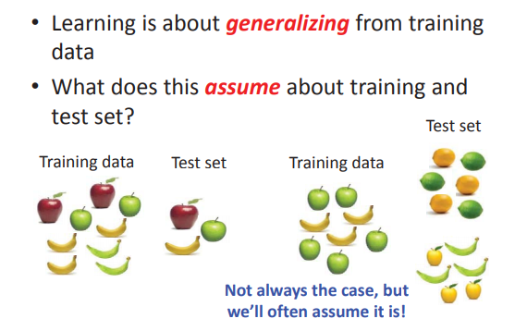
Learning System

Slide 31














Steps involved in creating a Machine Learning model
Model Building
1
2
3
Loading & understanding your data
Exploratory Data Analysis (EDA)
Splitting Train & Test Data
Business Problem
Data Collection
6
5
5
4
Deploy / Operationalize Model
Evaluate Model
Create & Train Model

Slide 32
Edge Impulse

Slide 33
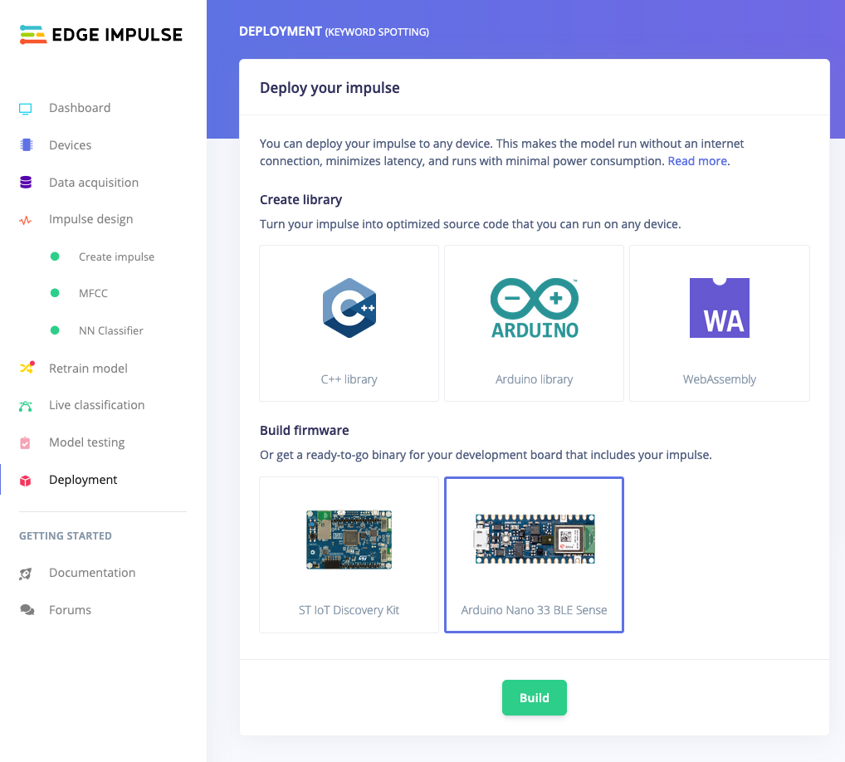
Edge Impulse

Slide 34
ML vs DL vs AI vs DS
Artificial
Intelligence
Intelligence with Actions
Data Science
(Maths, Statistics, Visualization, EDA)
Applied statistics for Data analysis and prediction
Machine
Learning
Data Driven Predictions
Deep Learning
Mimicking like human brain

Slide 35

Program Details
Python (10 Hours)
Module 1: Introduction to Python (1 hour)
Module 2: Variables, Data Types, and Operators (1.5 hours)
Module 3: Functions, Modules and Libraries (2 hours)
Module 4: Control Flow and Loops (1.5 hours)
Module 5: Data Structures (2 hours)

Slide 36

Program Details
Data Science (10 Hours)
Module 1: Introduction to Data Science (1 hour)
Module 2: Data Collection and Cleaning (2 hours)
Module 3: Exploratory Data Analysis (2 hours)
Module 4: Feature Engineering and Selection (2 hours)
Module 5: Model Building and Evaluation (3 hours)

Slide 37
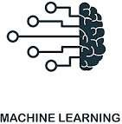
Program Details
Machine Learning (Hours)
Module 1: Introduction to Machine Learning (1 hour)
Module 2: Data Preprocessing (1.5 hours)
Module 3: Supervised Learning (2 hours)
Module 4: Unsupervised Learning (2 hours)
Module 5: Model Deployment and Ethics (3 hours)

Slide 38

Program Details
Web development (10 Hours - Online)
Module 1: Introduction to Web Development (1 hour)
Module 2: HTML and CSS (3 hours)
Module 3: Responsive Design and Layout (2 hours)
Module 4: JavaScript Fundamentals (2 hours)
Module 5: Web Development Tools and Deployment (2 hours)

Slide 39






THANK YOU!
THANK YOU!
For Further Information:
https://tih.iitr.ac.in/
www.uniconvergetech.in
www.theiotacademy.co
You can also visit us at:

